Slide 1
Open Targets: integrating genetics, omics and chemical data for translational research
EMBL
Heidelberg
Sep 12nd 2019
Denise Carvalho-Silva, PhD
EMBL-EBI | Open Targets
Wellcome Genome Campus
United Kingdom

Slide 2
Workshop materials
https://docs.targetvalidation.org/outreach/
latest-training-materials

Slide 3
This session 09:00-13:00
Introduction to Open Targets
Open Targets Platform: talk + live demo + exercises
Break → 10:30-10:45
Open Targets Genetics: talk + exercises
Feedback survey and wrap up

Slide 4
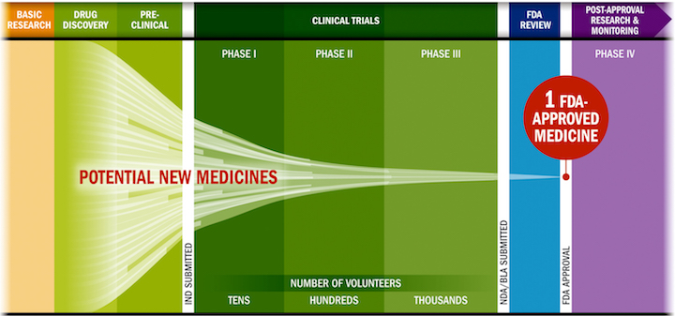
Drug discovery: some challenges
Lengthy, costly, low success rate, HIGH ATTRITION RATES
Source: PhRMA adaptation based on Tufts CSDD & School of Medicine, and FDA

Slide 5
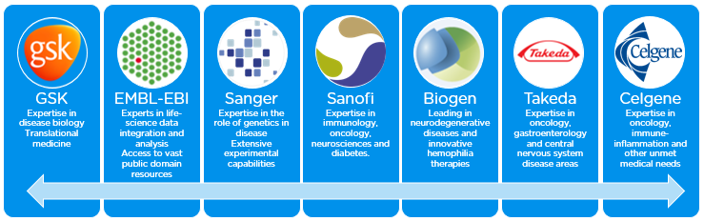
Open Targets
A partnership to transform drug discovery
Founding partners
2018
2016
2017
2018
Systematic identification and prioritisation of targets

Slide 6
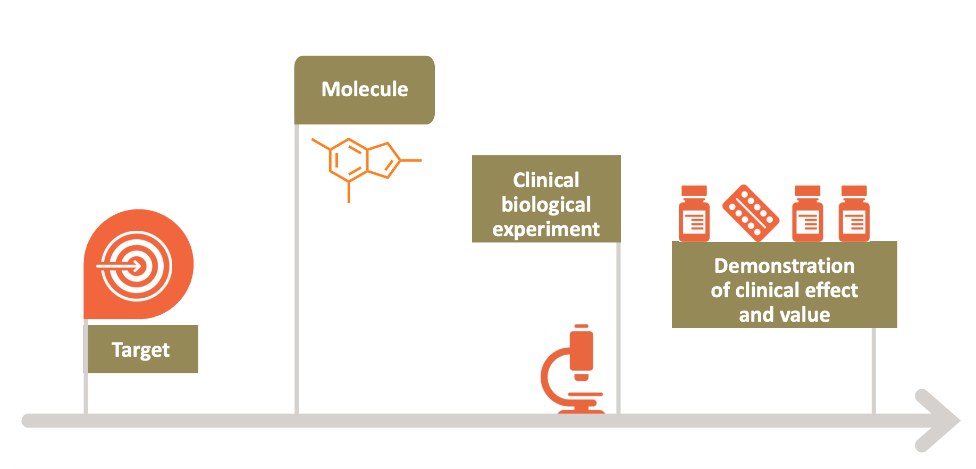
Selecting the right target
Drugs that fail are neither safe nor efficacious

Slide 7









Knowledge cycle
Public data
Experimental projects
Bioinformatics projects
DATA
GENERATION
DATA
INTEGRATION
Therapeutic hypothesis

Slide 8

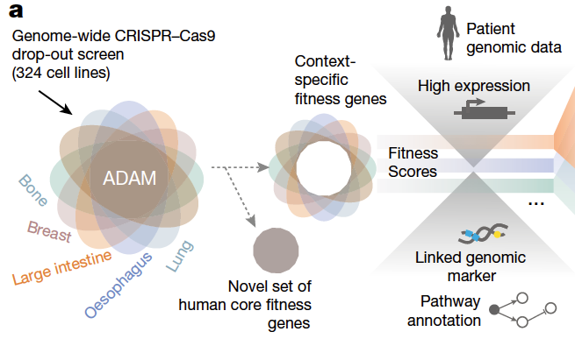
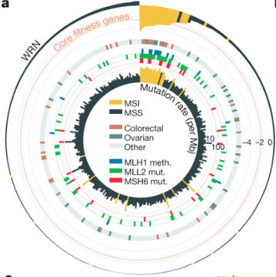
Behan et al (2019)
WRN sustains in vivo growth in:
colorectal
ovarian
endometrial
gastric
New candidate target for tumours with MSI (WRN antagonists)

Slide 9
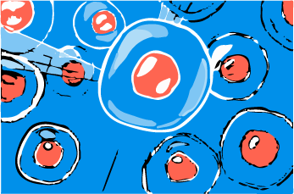
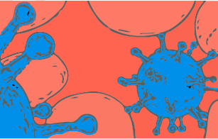
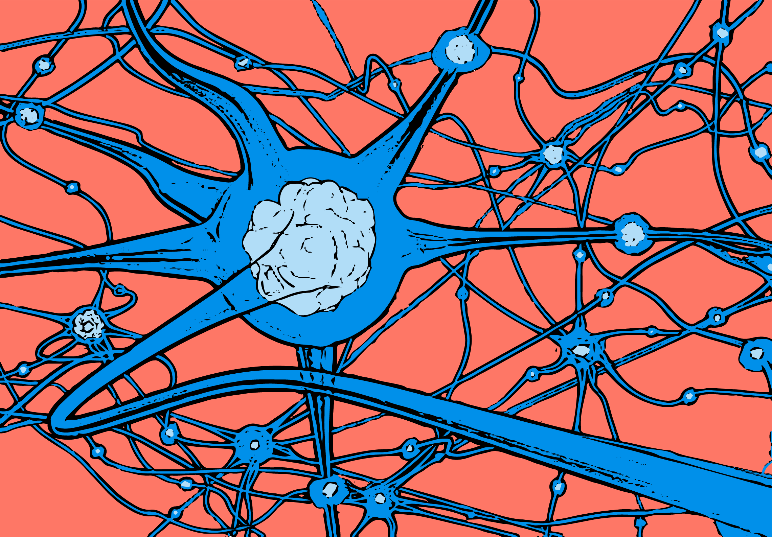
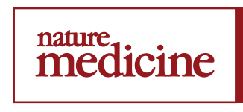
Data generation: therapeutic areas
5 ongoing projects
7 ongoing projects
9 ongoing projects
3 complete projects
2 complete projects
3 manuscripts on bioRxiv
1 publication (2019)
1 publication (2019)

Slide 10
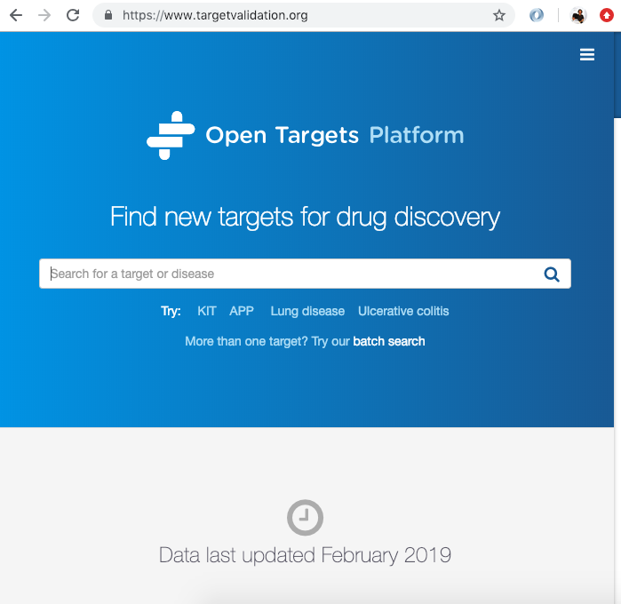
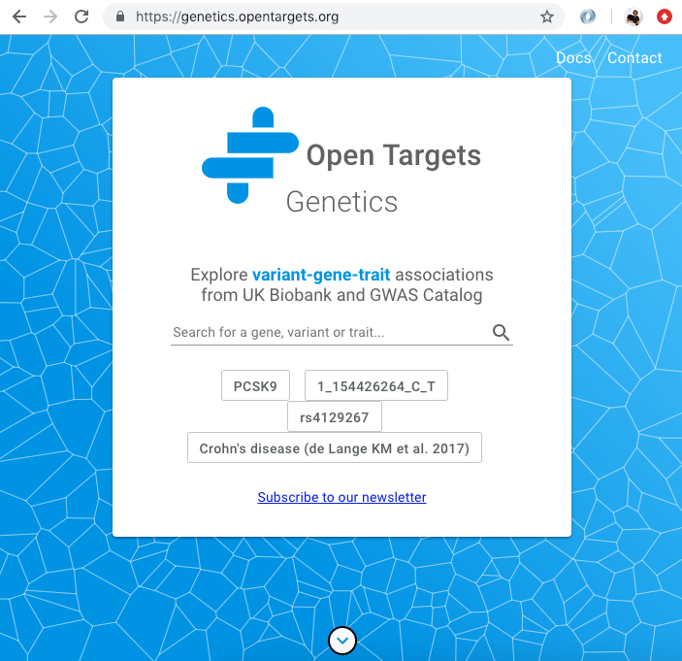
Data integration: web resources
Data integration: Open Targets
https://www.opentargets.org/resources/#open-targets-platform

Slide 11
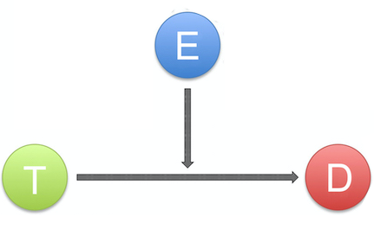
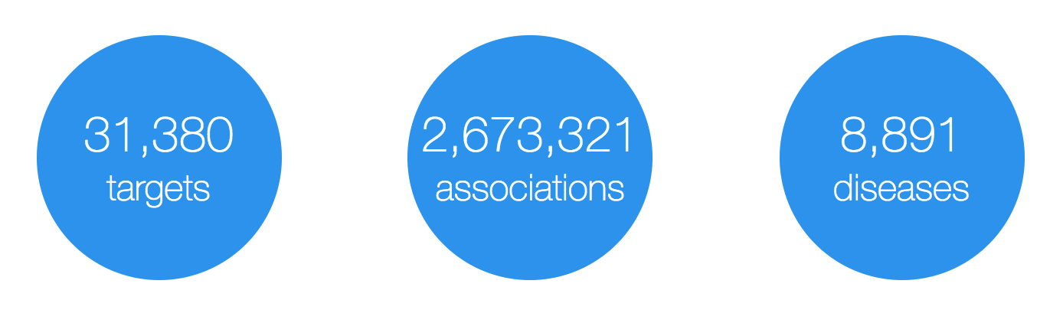
Open Targets Platform: data model
Evidence
(variants, drugs, literature, etc)
Target
(protein and non-protein coding genes)
Disease
(rare and common)
https://www.targetvalidation.org

Slide 12
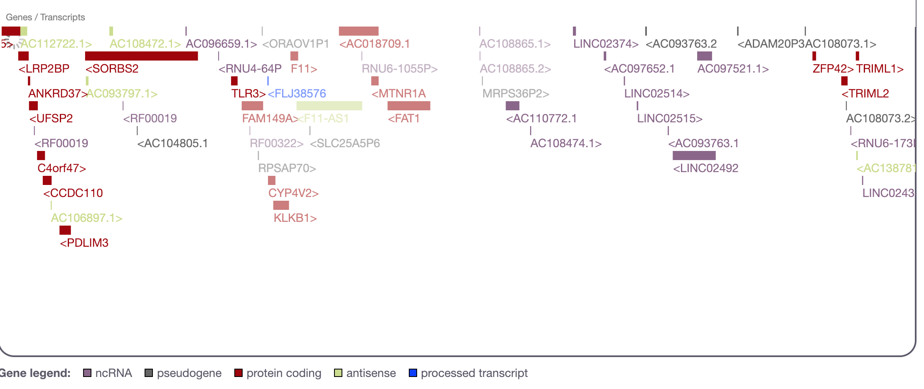
What is a target?
27K
targets
Examples
https://www.targetvalidation.org/target/ENSG00000255248
https://www.targetvalidation.org/target/ENSG00000175482?view=sec:genome_browser

Slide 13
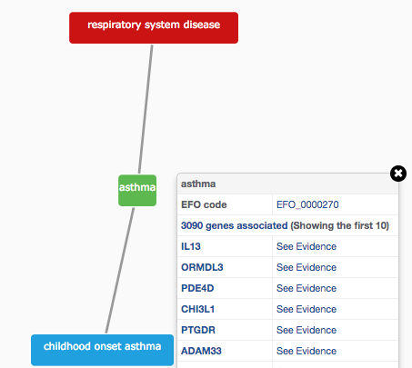
How do we describe our diseases?
Modified version of Experimental Factor Ontology (EFO)
Controlled vocabulary (Coeliac versus Celiac)
Hierarchy (relationships)
Promotes consistency
Increases the richness of annotation
Allow for easier and automatic integration
10K
diseases

Slide 14
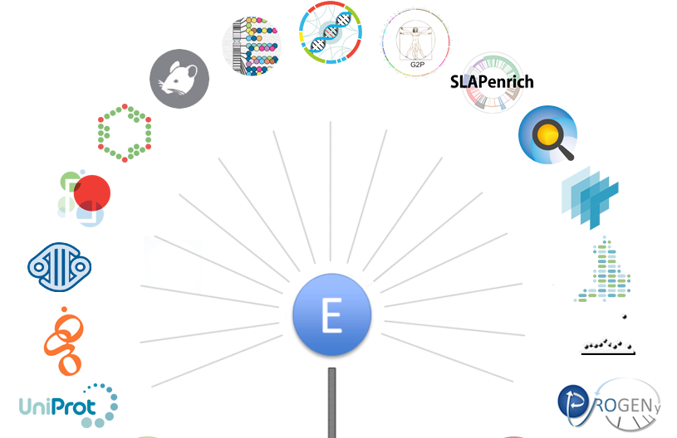
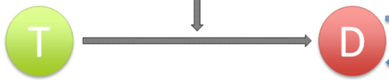
Evidence for target-disease associations
https://docs.targetvalidation.org/data-sources/data-sources

Slide 15
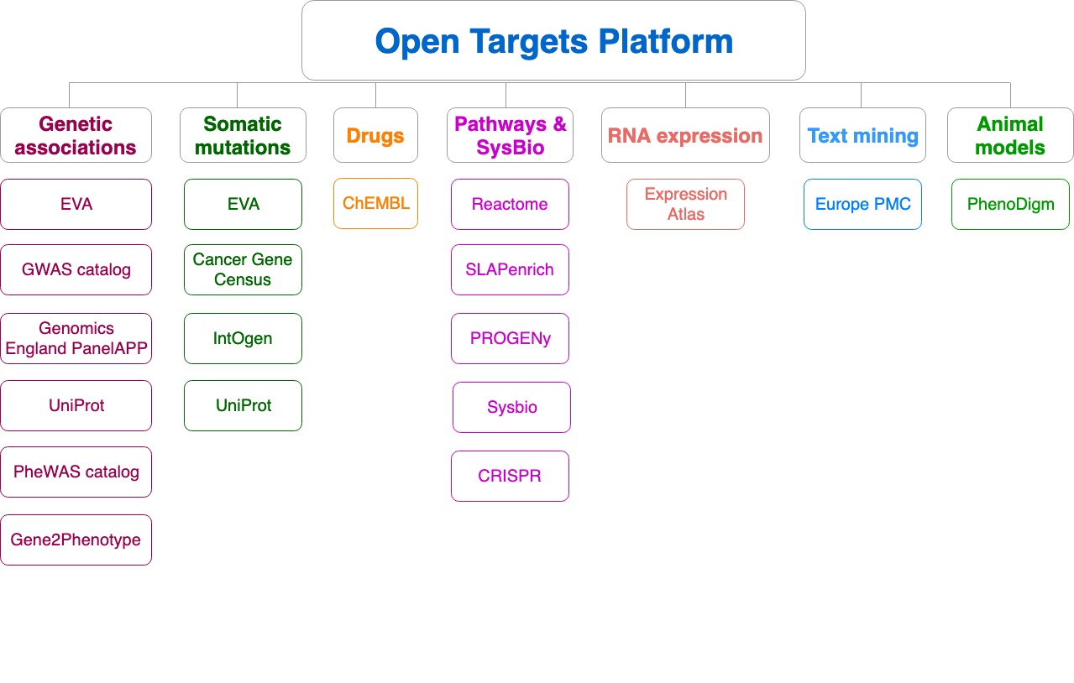
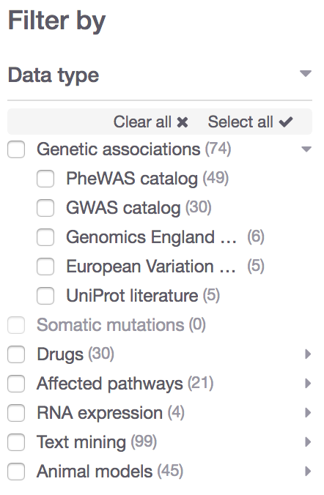
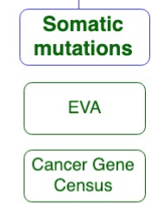
Data sources grouped into data types
Data type
Data source

Slide 16

What can you do with the Open Targets Platform?
Target-disease associations (+ evidence + score)
https://www.targetvalidation.org/evidence/ENSG00000141510/EFO_0000228
Target annotations
http://www.targetvalidation.org/target/ENSG00000141510
Disease annotations
http://www.targetvalidation.org/diseaset/EFO_0000228

Slide 17
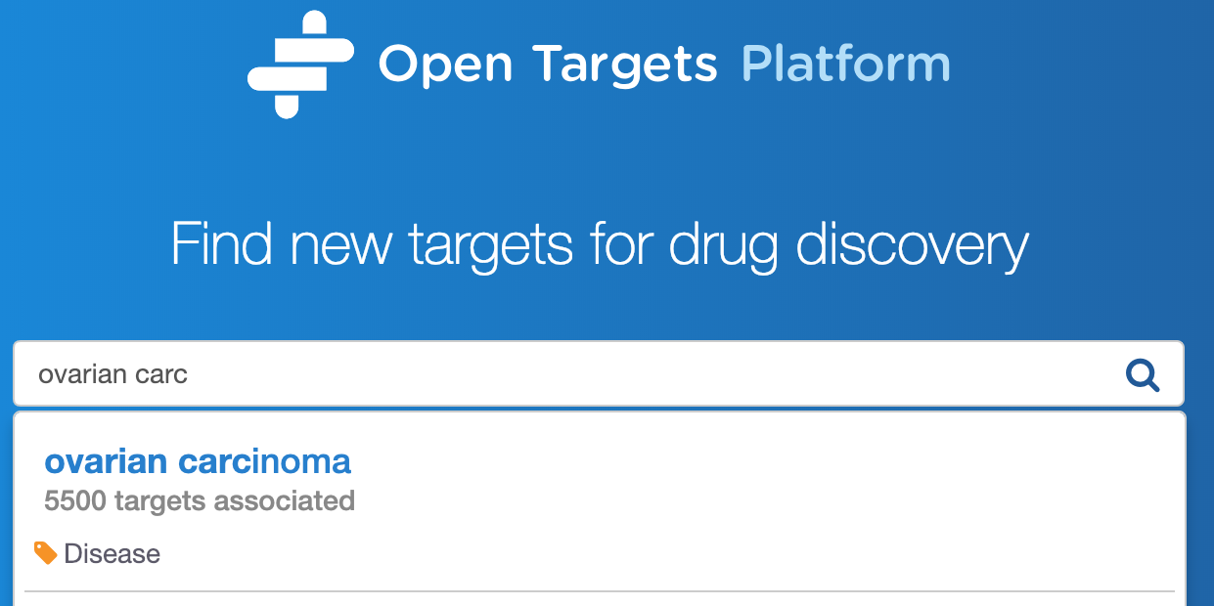
Demo 1
Which targets are associated with my disease?
What is the evidence for the association?
Is there any data to help to prioritise the list of associated targets?
Coursebook: pages 7-16

Slide 19
What can you do with the Open Targets Platform?
Target-disease associations (+ evidence + score)
https://www.targetvalidation.org/evidence/ENSG00000141510/EFO_0000228
Target annotations
https://www.targetvalidation.org/target/ENSG00000141510
Disease annotations
https://www.targetvalidation.org/diseaset/EFO_0000228

Slide 20
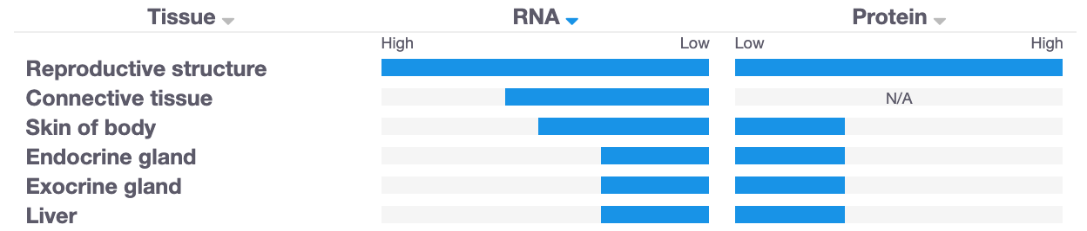
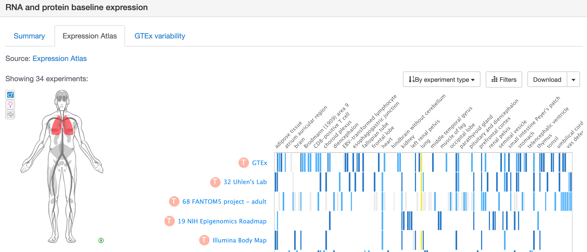
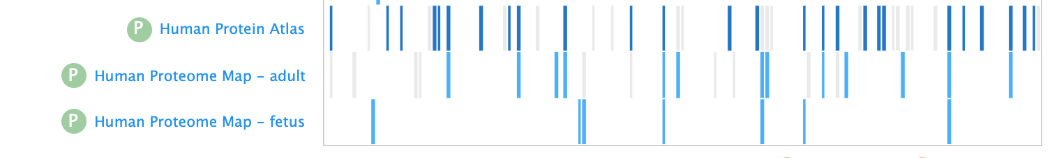
Is my target expressed in the relevant tissue?

Slide 21
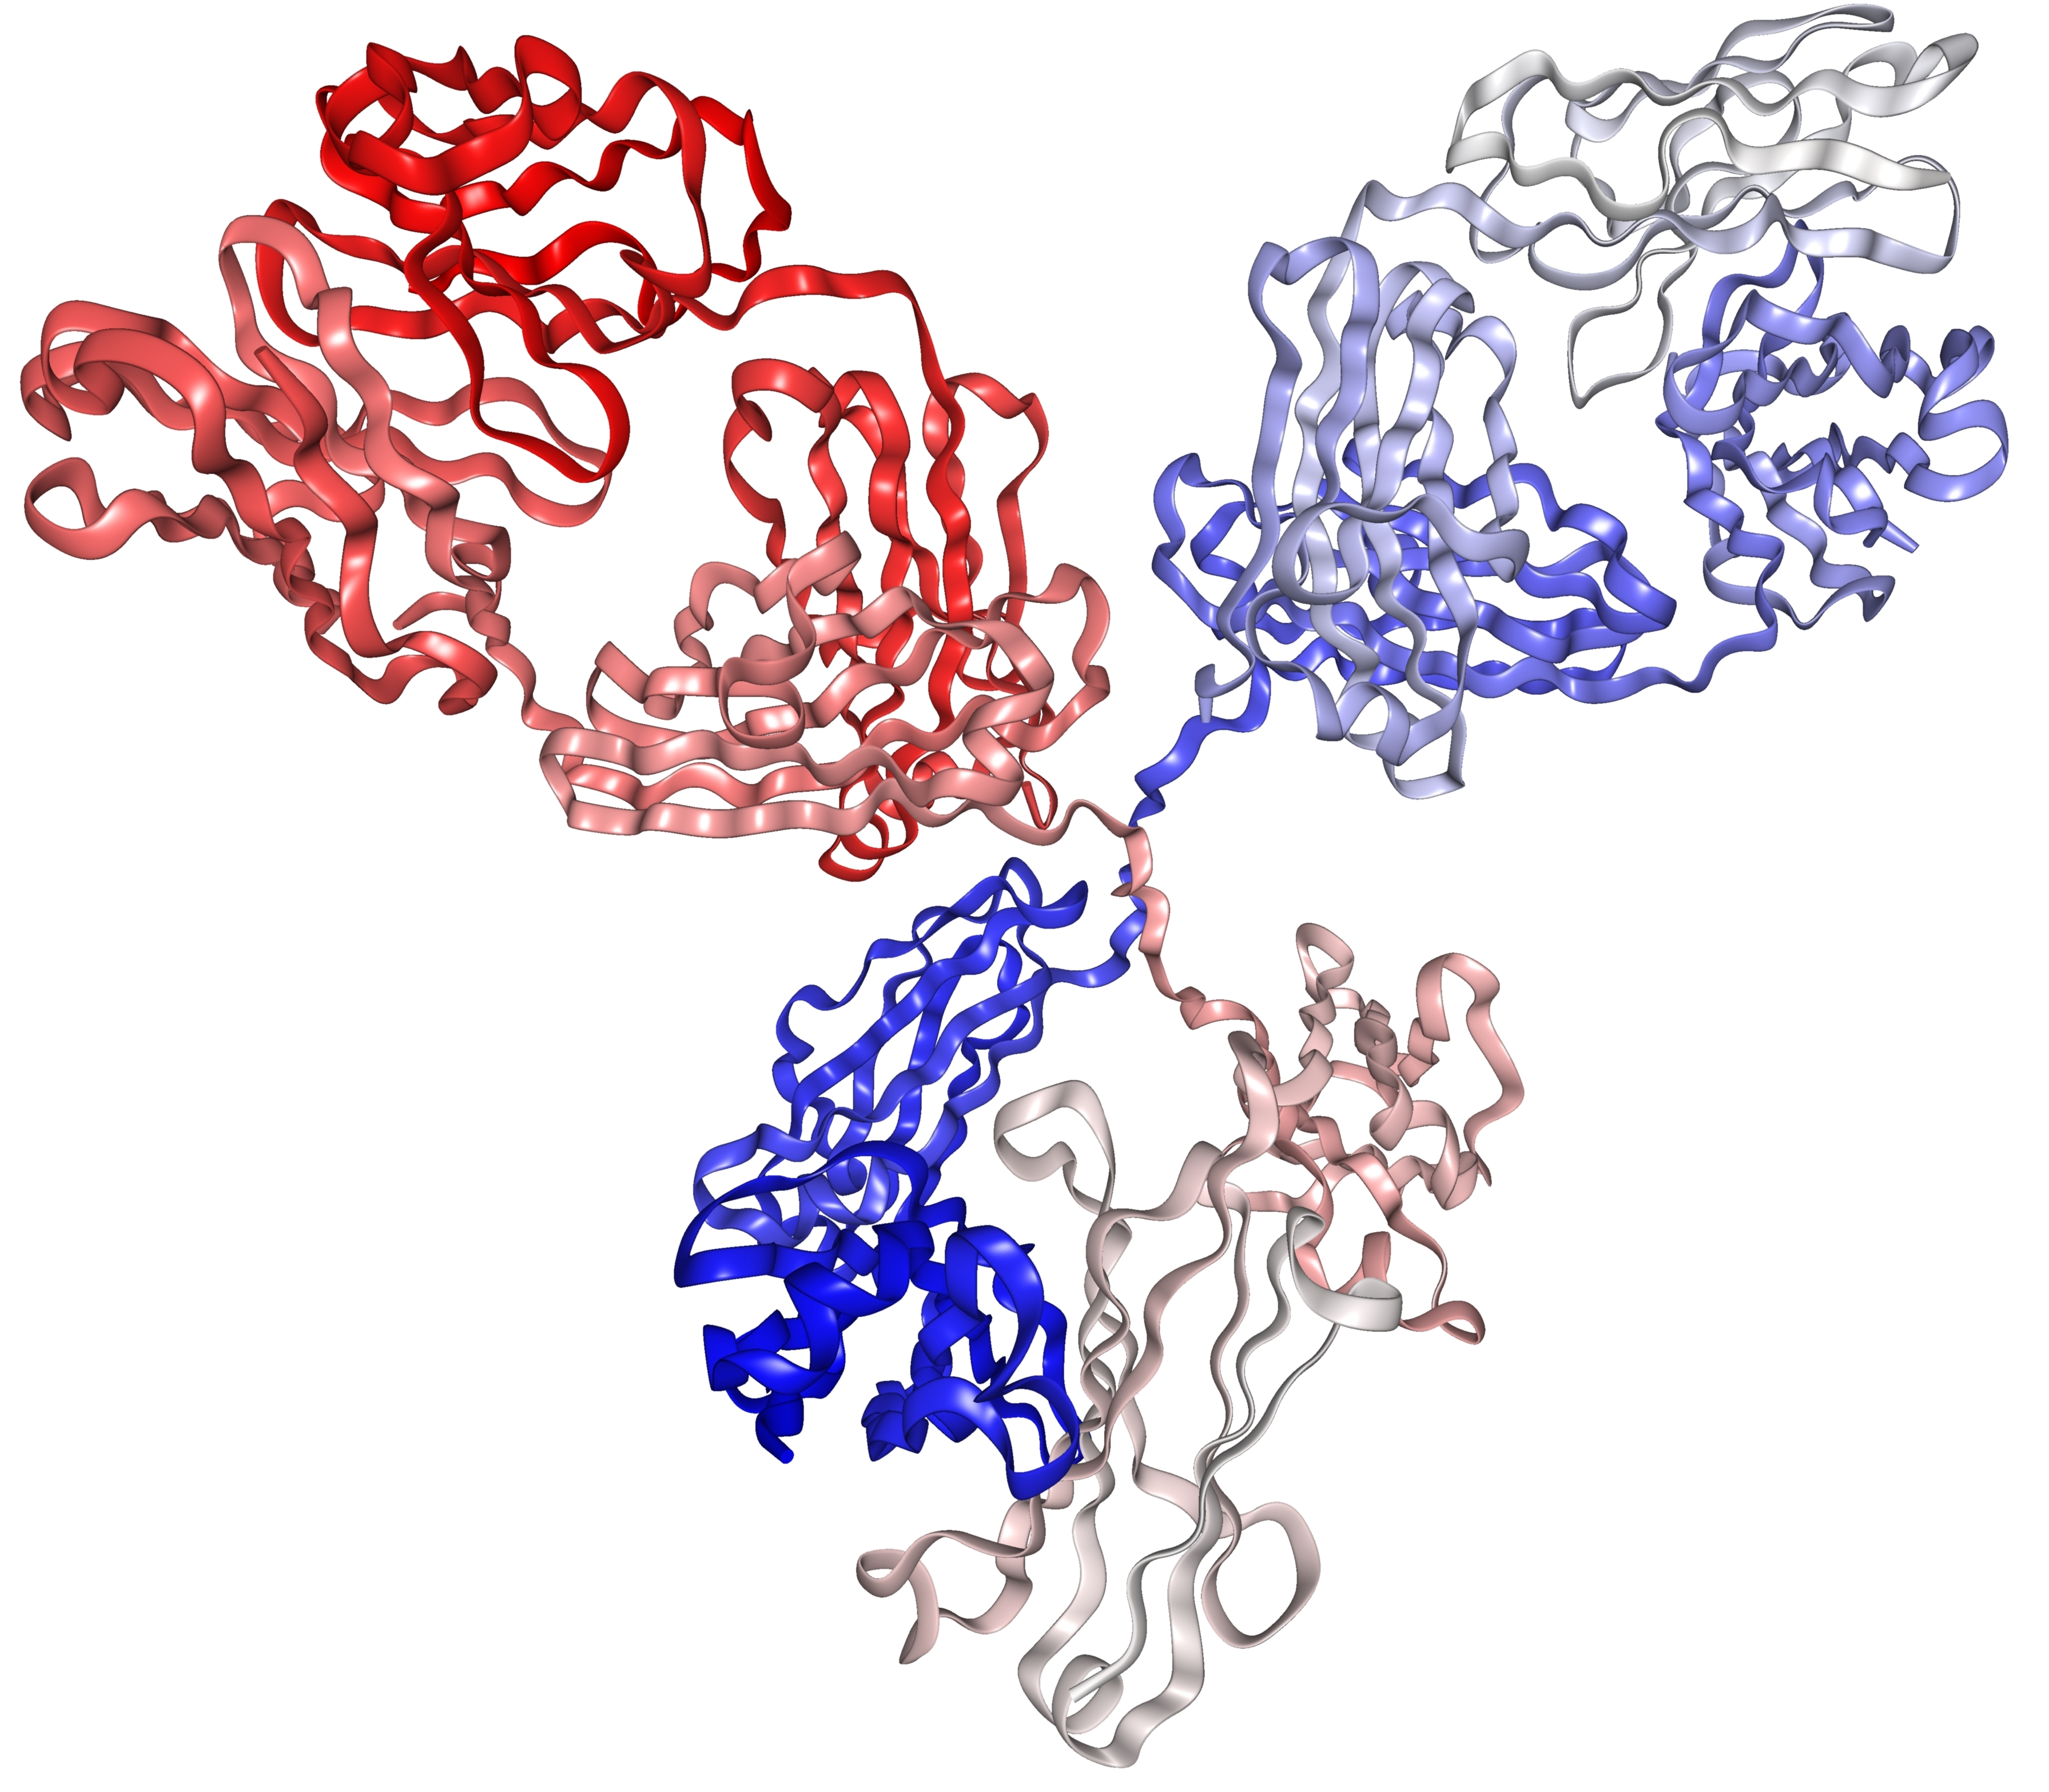
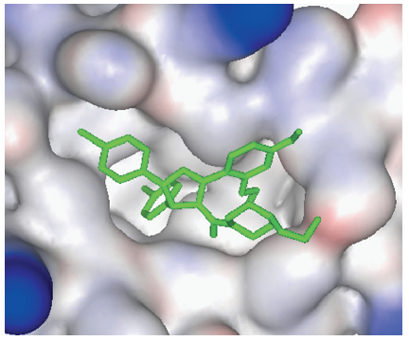
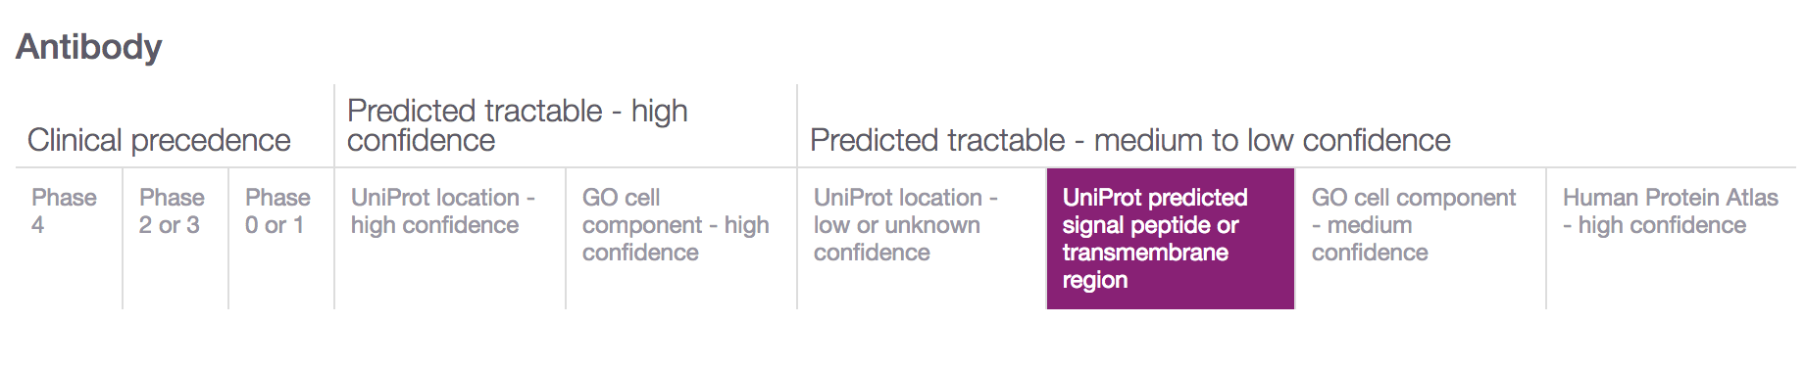
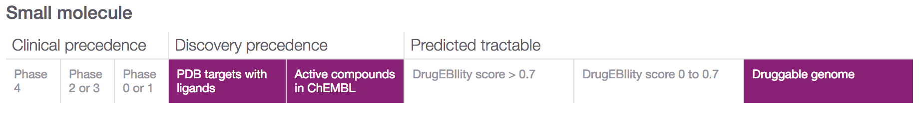
Is my target tractable?
DOI:10.1517/17460441.3.4.391
https://www.immunology.org/structure-antibody-1972

Slide 22
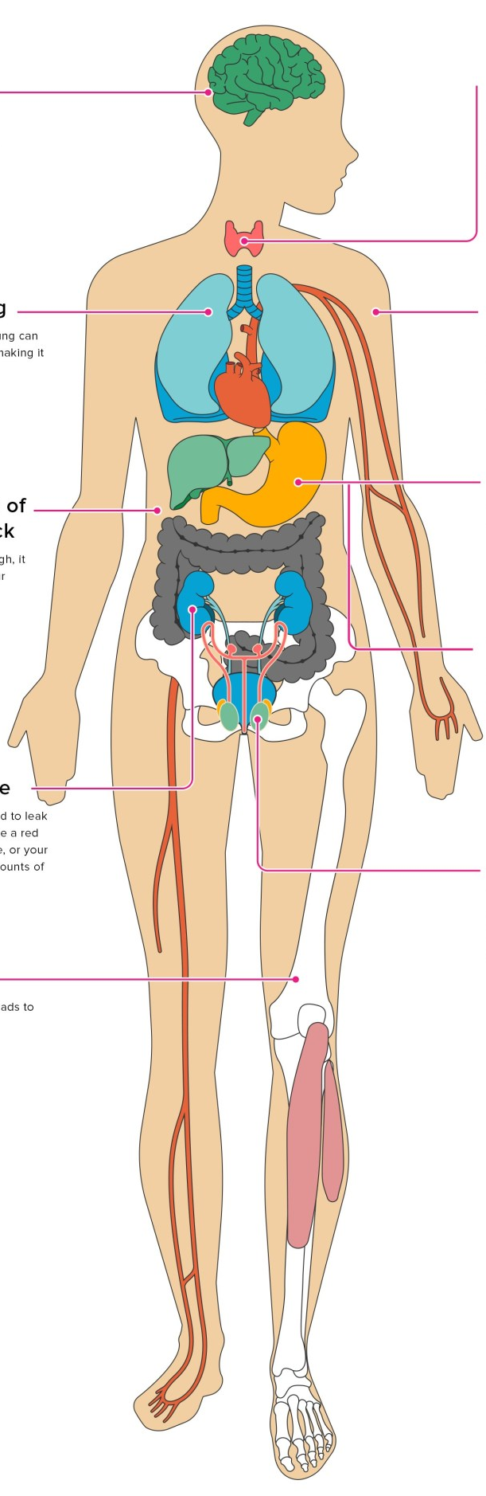
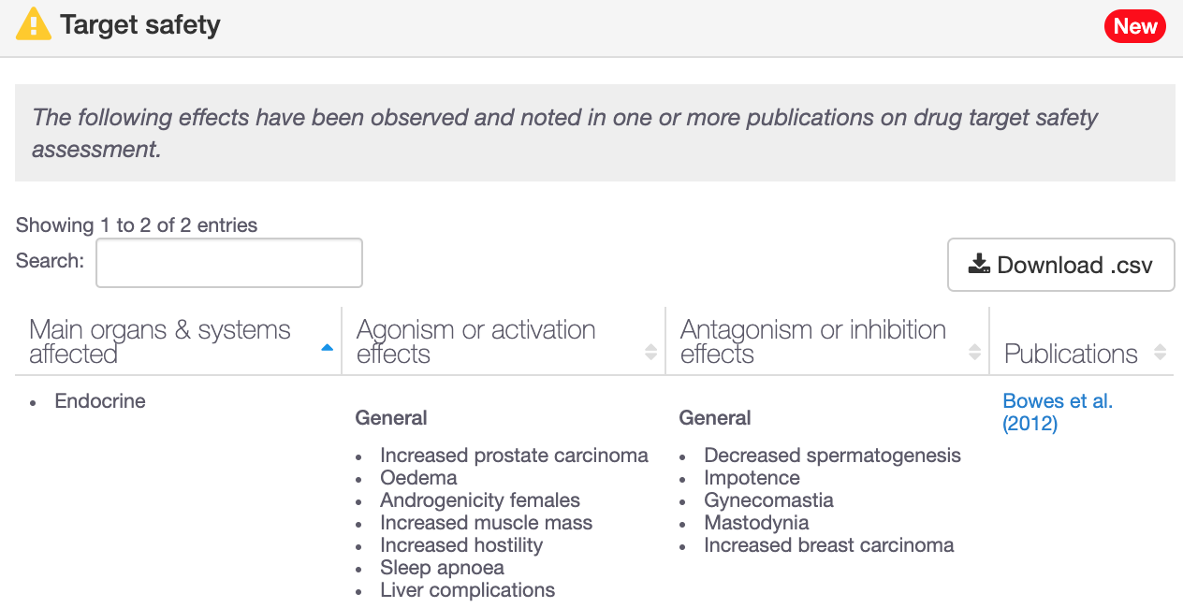
Is my target safe to be modulated?
193 genes with target safety information
Drowsiness
Increased heart rate
Hepatotoxicity

Slide 23
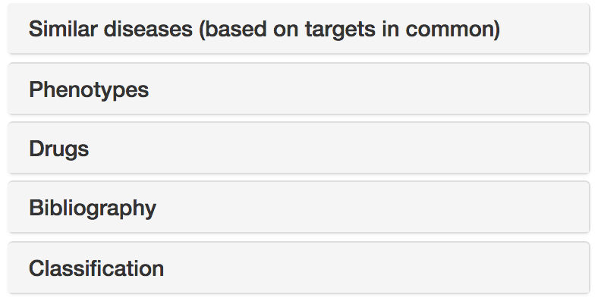




Disease annotations
Disease profile page
https://docs.targetvalidation.org/getting-started/getting-started/disease-profile

Slide 24
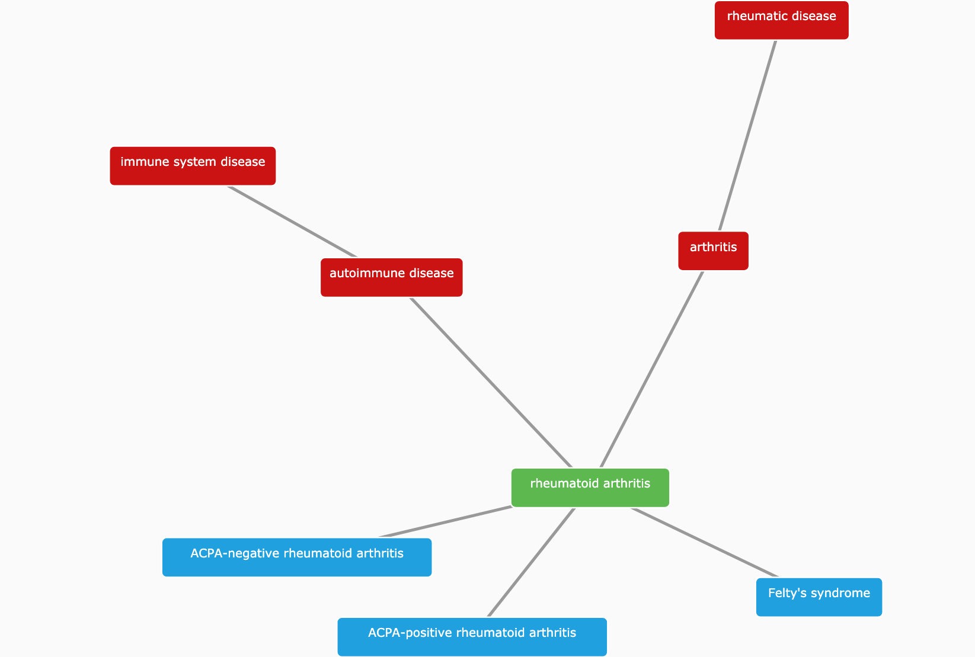
(Disease) Classification
https://www.targetvalidation.org/disease/EFO_0000685

Slide 25
Hands-on time
Demos
Exercises
Target (disease) annotations
Target centric workflow
Durvalumab
IBD
EGRF
Pages 16-25
Pages 26-29

Slide 26
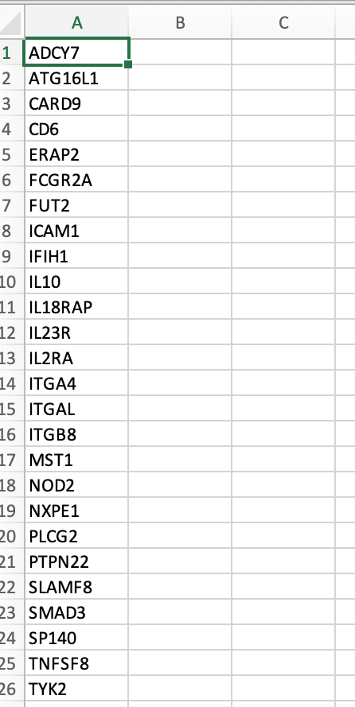
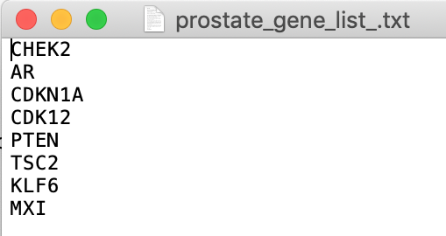
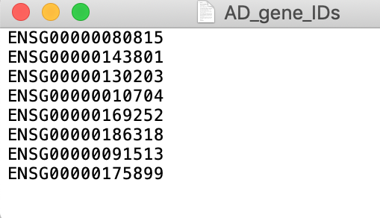
Have you got a list of targets?
Using the web interface, choose
Batch search or
“Your target list” filtering

Slide 27
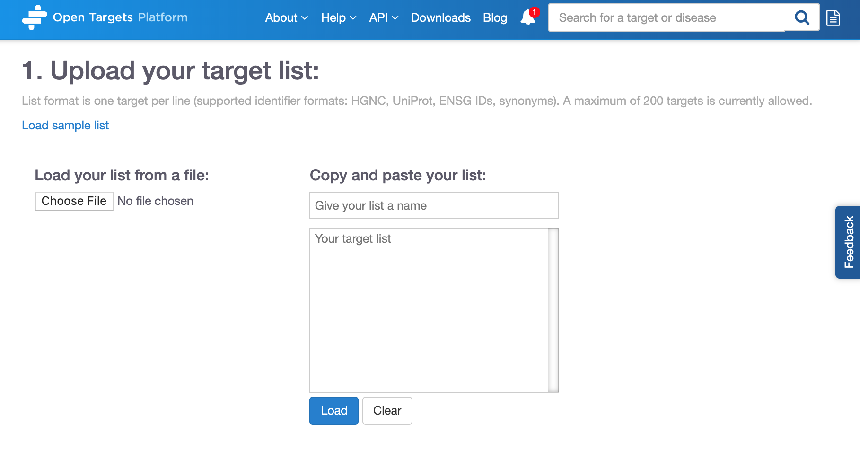
Batch search
https://www.targetvalidation.org/batch-search

Slide 28
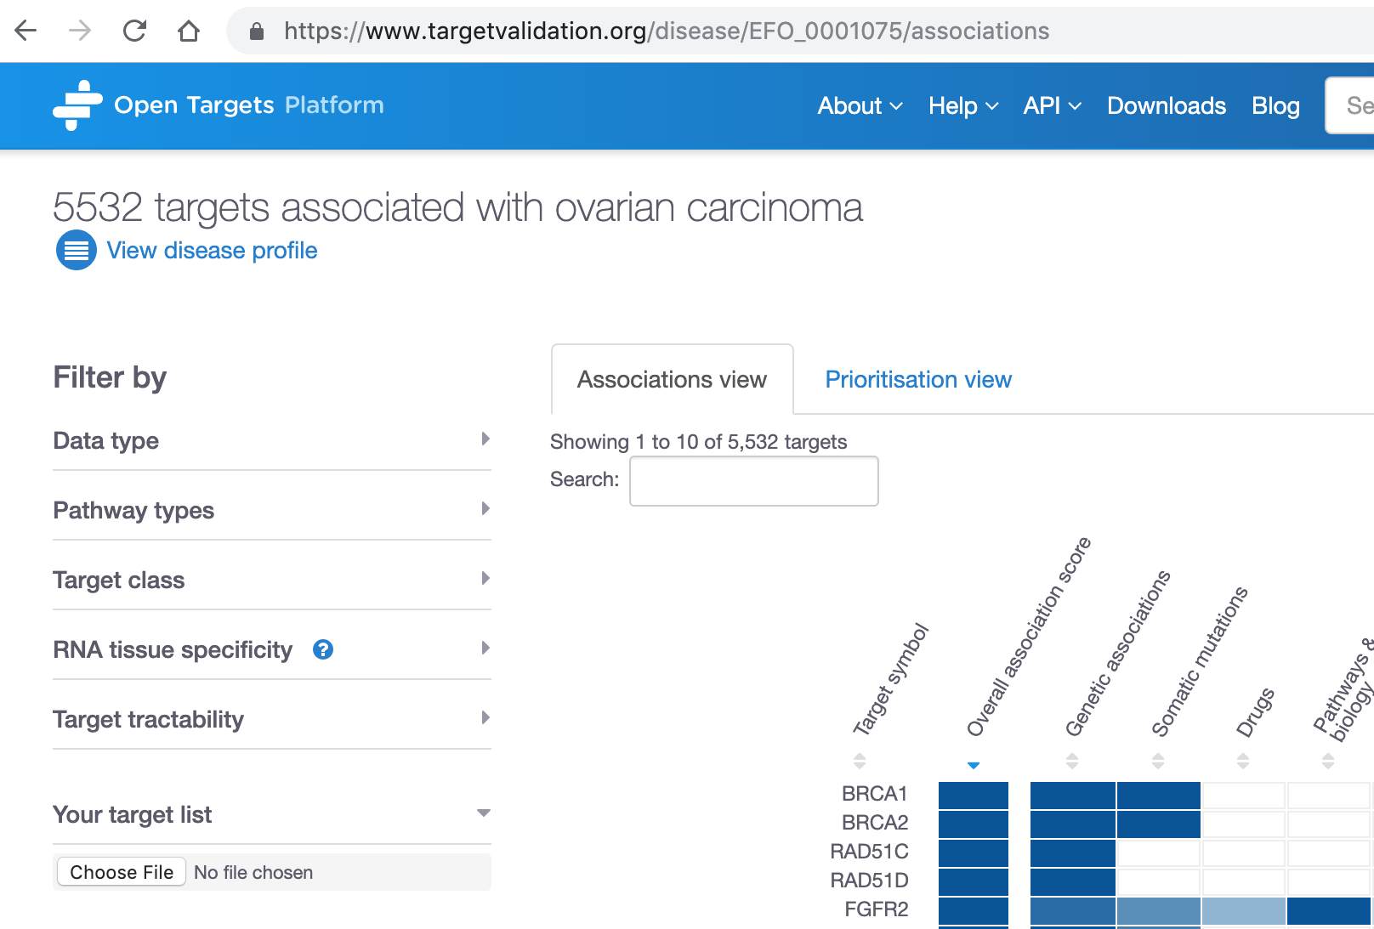
Your target list

Slide 29




Open Targets Platform REST API*
Server
https://platform-api.opentargets.io/v3/platform/
Endpoint
public/association/filter
Parameters
?target=ENSG00000163914&size=10000&fields=target.id&fields=disease.id
Open Targets Python client **
*
https://docs.targetvalidation.org/tutorials/rest-api
**
https://docs.targetvalidation.org/tutorials/python-client

Slide 30
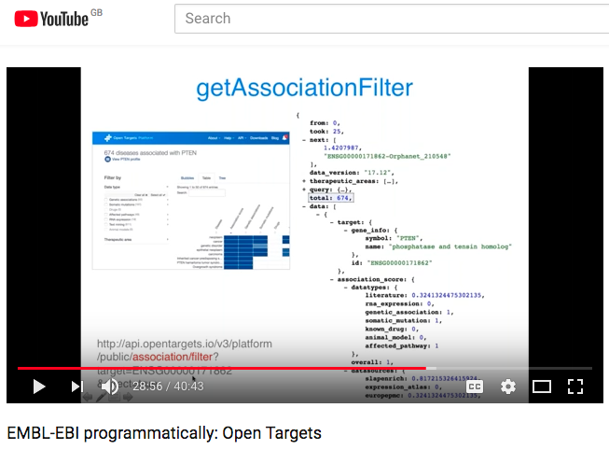
REST API
https://youtu.be/KQbfhwpeEvc

Slide 31
Extra hands-on exercises
E1-E3
Pages 33-35

Slide 32
Data integration: web resources
Data integration: Open Targets
https://www.opentargets.org/resources/#open-targets-platform

Slide 33
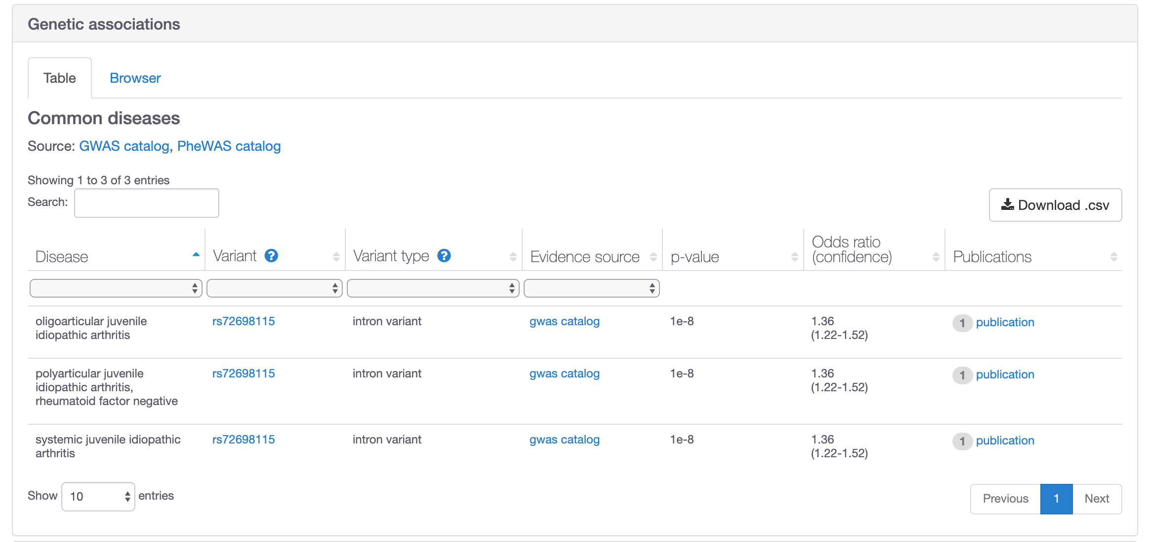
Open Targets Genetics. Why?
Variants in Open Targets Platform annotated with VEP
Refine genetic associations in the
Open Targets Platform
https://www.targetvalidation.org/evidence/ENSG00000160712/EFO_0002609?view=sec:genetic_association

Slide 34
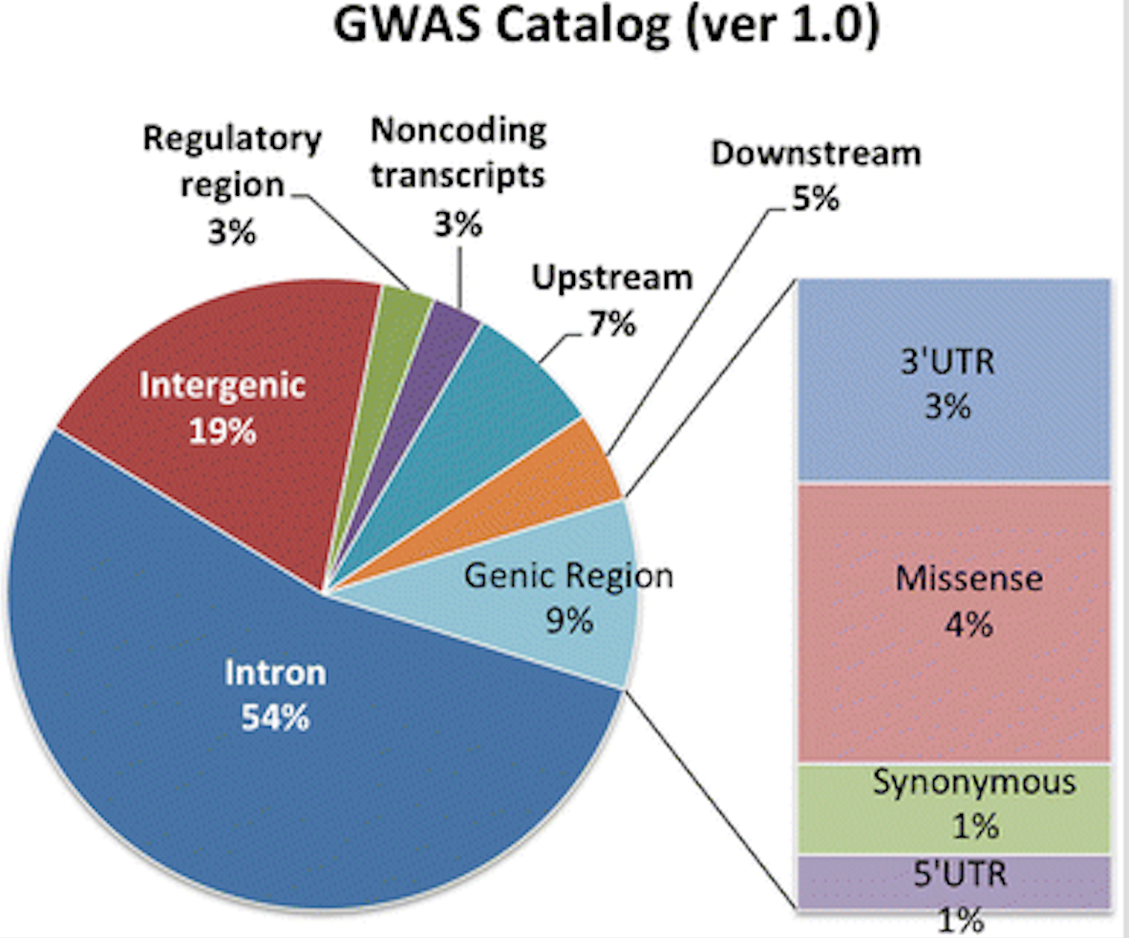

Open Targets Genetics. Why?
Majority loci NOT in coding regions
Make sense of GWAS
Improve signal mapping
Glimpses of the biology
Lee et al (2017): PMID:29288389
2/3 of GWAS loci implicate a gene that is not the nearest gene to the most associated SNP

Slide 35
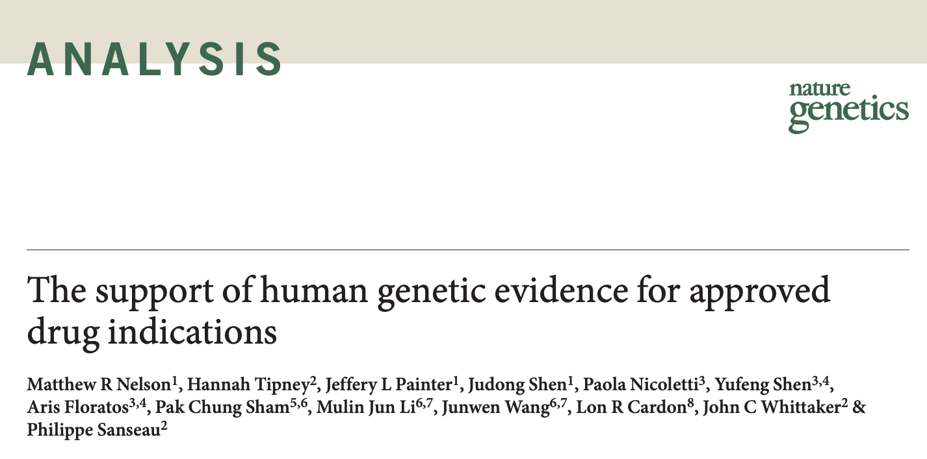


Open Targets Genetics. Why?
Genetics increases success
Can it be used to guide target ID?
Both rare and common variants

Slide 36
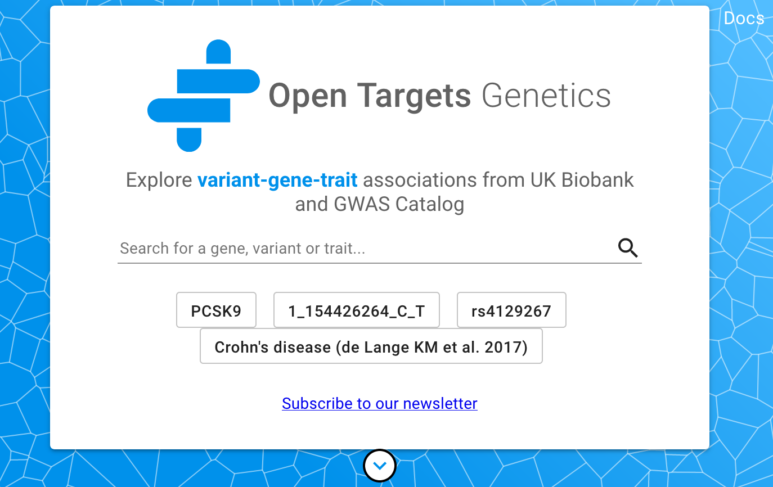
Key question
Which targets are implicated in disease from common variant genetic analysis?
https://genetics.opentargets.org
Notes:
Mechanism behind GWAS signal…
Improve map of GWAS signal and gens (behind)
Explain QTL
From sequence to consequence

Slide 37

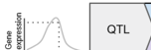
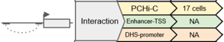

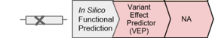
Open Targets Genetics: data sources
Variants – Traits
Variants – Gene
~ 5000 SNP-trait associations
201 summary statistics
eQTL
91 tissues
pQTL
Blood
2,139 summary statistics (Neale round 2)
1,281 summary statistics (SAIGE)
Distance to TSS (transcript start site)
https://genetics-docs.opentargets.org/our-approach/data-sources
Notes:
Summary stats for fine-mapping
What is the minimal set of likely causal variants?
Are the variants associated with other phenotypes?
Which genes are functionally implicated? Can we assess the directionality (increase or decrease)? Is it cell/tissue specific?
Are there known drugs target

Slide 38
Open Targets Genetics: data model
Aggregated functional score
(V2G)
r²
Posterior Prob.
S
p-value
V_{L}
V_{T}
G
GWAS Catalog
UK Biobank
Fine mapping
LD expansion
TSS distance
eQTL
pQTL
PCHI-C
FANTOM5
VEP
S Study (traits from UK Biobank and GWAS catalog)
V_{L} Lead variant (associated with traits from GWAS catalog)
V_{T} Tag variant (possible causal, expanded from V_{L})
G Gene
https://genetics-docs.opentargets.org/our-approach/pipeline-overview

Slide 39
Aggregated functional score (V2G)
For each S-V_{L} pair, we expand V_{L} to a likely causal set of V_{T}
Fine-mapping
LD expansion
V_{T}
G
V_{T}
S
V_{L}
G
V_{T}
G
V_{T}

Slide 40
Aggregated functional score (V2G)
Use functional genomics to link V_{T} to functionally implicated genes
V_{T}
G
V_{T}
S
V_{L}
G
V_{T}
G
V_{T}

Slide 41
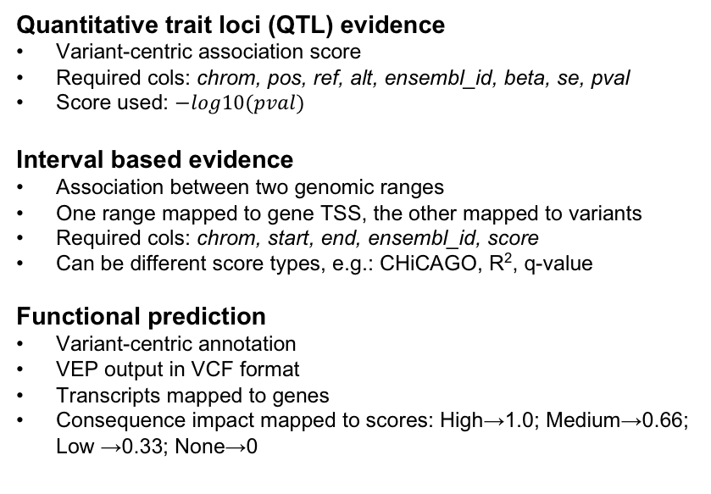
Aggregated functional score (V2G)
V
G
V
G
V
G
V
Distance variant-TSS

Slide 42
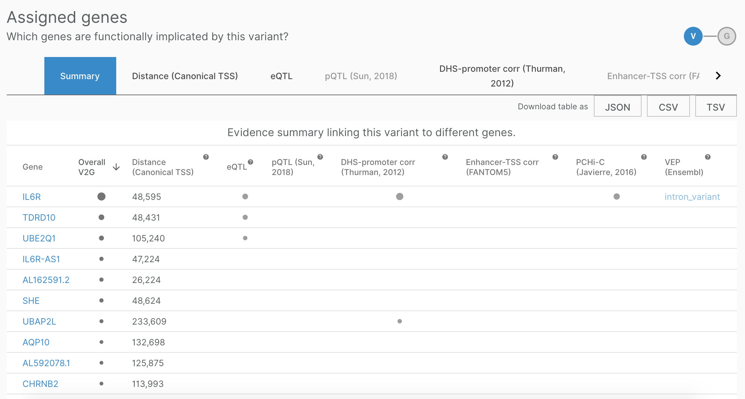
Variant-to-gene (V2G) score

Slide 43
What can you do with Open Targets Genetics?
Search for a variant to find genes and traits
https://genetics.opentargets.org/variant/1_154453788_C_T
Search for a trait to find associated loci
https://genetics.opentargets.org/study/GCST003044
Search for a gene to find its associated traits
https://genetics.opentargets.org/gene/ENSG00000169174

Slide 44
Hands-on time
Exercises
LDL cholesterol
ITGA4
Pages 29-32

Slide 45


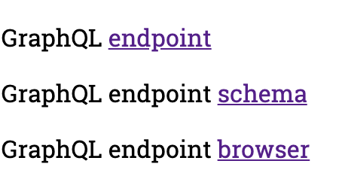
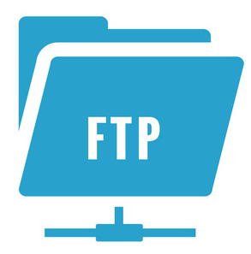
How to access all this data programmatically?
Bulk download*
GraphQL API
http://genetics-api.opentargets.io/

Slide 46
Wrapping up
Public data
Experimental projects
Bioinformatics projects
DATA
GENERATION
DATA
INTEGRATION
Therapeutic hypothesis

Slide 47
Open Targets Platform and Genetics
Resources of integrated data (omics, genetics, drug)
Target identification and prioritisation
Graphical web interfaces, APIs, download
http://blog.opentargets.org/tag/release-notes/
http://blog.opentargets.org/tag/genetics-releases/

Slide 48
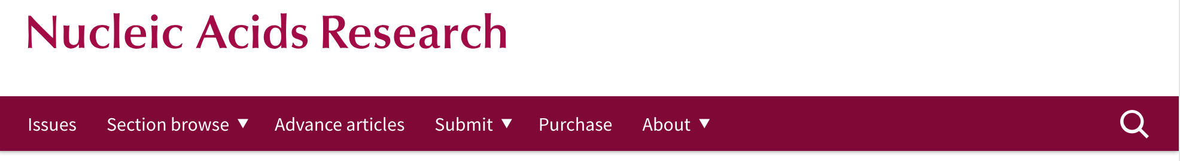

Want to learn more?
http://bit.ly/cite-us

Slide 49




Get in touch
Open Targets Platform | Open Targets Genetics
docs.targetvalidation.org | genetics-docs.opentargets.org
support@targetvalidation.org | geneticsportal@opentargets.org
@targetvalidate
blog.opentargets.org/
http://tinyurl.com/opentargets-in
https://tinyurl.com/opentargets-youtube

Slide 50










Thank you!

Slide 51

Looking for your new career move?
https://www.opentargets.org/jobs

Slide 52
Extra extra extra
Details on data sources to associate
targets and diseases
Other Open Targets resources

Slide 53






Data sources: GWAS catalog
Genome Wide Association Studies
Array-based chips → genotyping 100,000 SNPs genomewide

Slide 54


Data sources: UniProt
Protein: sequence, annotation, function
Manual curation of coding variants in patients
EMBL-EBI train online

Slide 55

Data sources: Gene2Phenotype
Variants, genes, phenotypes in rare diseases
Literature curation → consultant clinical geneticists in the UK

Slide 56
Data sources: UniProt
Protein: sequence, annotation, function
Manual curation of coding variants in patients
EMBL-EBI train online

Slide 57

Data sources: PheWAS
Phenome Wide Association Studies
A variant associated with multiple phenotypes
Clinical phenotypes derived from EMR-linked biobank BioVU
ICD9 codes mapped to EFO

Slide 58

Data sources: GE PanelApp
Aid clinical interpretation of genomes for the 100K project
We include ‘green genes’ from version 1+ and phenotypes

Slide 59

Data sources: EVA
With ClinVar information for rare diseases
Clinical significance: pathogenic, protective
EMBL-EBI train online

Slide 60

Data sources: The Cancer Gene Census
Genes with mutations causally implicated in cancer
Gene associated with a cancer plus other cancers associated with that gene

Slide 61

Data sources: IntOGen
Genes and somatic (driver) mutations, 28 cancer types
Involvement in cancer biology
Rubio-Perez et al. 2015
Notes:
Somatic mutations from cancer drivers genes across 28 tumor types. We have imported data (2014.12) from 6,792 samples spanning 28 cancer types (Rubio-Perez et al)."

Slide 62

Data sources: ChEMBL
Known drugs linked to a disease and a known target
FDA approved for clinical trials or marketing
EMBL-EBI train online

Slide 63

Data sources: Reactome
Biochemical reactions and pathways
Manual curation of pathways affected by mutations
EMBL-EBI train online

Slide 64

Data sources: SLAPenrich
374 pathways curated and mapped to cancer hallmarks
Divergence of the total number of cancer samples with genomic alterations
Mutational burden and total exonic block length of genes

Slide 65

Data sources: PROGENy
Comparison of pathway activities between normal and primary samples from The Cancer Genome Atlas
Inferred from RNA-seq: 9,250 tumour and 741 normal samples
EGFR, hypoxia, JAK.STAT, MAPK, NFkB, PI3K, TGFb, TNFa, Trail, VEGF, and p53
Notes:
Linear regression model
from 14 tumour types.

Slide 66
Data sources: SysBio
Curation of four systems biology papers
Available for six gene lists: ~ 400 genes
Late onset Alzheimers, cognitive decline, CHD, and IBD
Score: p-values or rank-based scores if available, otherwise 0.5 is assigned.
Notes:
Linear regression model
from 14 tumour types.

Slide 67

Data sources: Expression Atlas
Baseline expression for human genes
- target profile page
Differential mRNA expression (healthy versus diseased):
- target-disease associations
EMBL-EBI train online

Slide 68

Data sources: Europe PMC
Mining titles, abstracts, full text in research articles
Target and disease co-occurrence in the same sentence
Dictionary (not NLP)
EMBL-EBI train online

Slide 69

Data sources: PhenoDigm
Semantic approach to associate mouse models with diseases

Slide 70

















How the data* flows
Target Profile
JSON
summary
document
Validator
Association
score
calculation
Disease profile
* e.g. genetic variants from NHGRI-GWAS catalog

Slide 71


How well supported are the associations?
Association score to convey confidence
More evidence → stronger association score
Different evidence are scored and weighted in different ways
Overall score
Genetic
Somatic
Drugs
Pathways
Expression
Text mining
Animal mod

Slide 72
Evidence score to overall score
Statistical integration, aggregation and scoring
1) Evidence score (e.g. one SNP from a GWAS paper)
2) Data source score (e.g. all SNPs from the GWAS catalog)
3) Data type score (e.g. all sources of Genetic associations)
4) Overall association score
https://docs.targetvalidation.org/getting-started/scoring

Slide 73
Computing the score for one evidence
score = f * s * c
f, relative occurrence of a target-disease evidence
s, strength of the effect of the variant
c, confidence of the observation for the target-disease evidence
f = sample size (cases and controls)
s = predicted functional consequence (VEP)
c = p value reported in the paper
(Factors affecting the relative strength of GWAS Catalog evidence)

Slide 74

https://docs.targetvalidation.org/getting-started/scoring
Factors affecting the relative strength of the evidence

Slide 75
Harmonic sum
Σ_{H}
*1.0
Genomics England
Score: 0 to 1 (max)
Σ_{H}
*1.0
PheWAS catalog
Σ_{H}
*1.0
European Variation Archive (germline)
Σ_{H}
*1.0
Σ_{H}
Genetic associations
Calculated at four levels:
Evidence
Data source
Data type
Overall
UniProt
Σ_{H}
*1.0
Gene2Phenotype
Σ_{H}
*1.0
GWAS catalog
Σ_{H}
*1.0
Cancer Gene Census
Σ_{H}
*1.0
European Variation Archive (somatic)
Σ_{H}
Somatic mutations
Σ_{H}
*1.0
IntOGen
Aggregation with (harmonic sum)
Σ_{H}
Σ_{H}
*1.0
ChEMBL
Drugs
Σ_{H}
*1.0
Reactome
Note: Each data set has its own scoring and ranking scheme
Σ_{H}
*0.5
SLAPenrich
Σ_{H}
*0.5
Σ_{H}
Pathways &
systems biology
PROGENy
Σ_{H}
*0.5
Sysbio
Σ_{H}
*0.2
Expression Atlas
RNA expression
Σ_{H}
*0.2
Europe PMC
Text mining
Σ_{H}
*0.2
PhenoDigm
Animal models
weight factor
Σ_{H}
S₁ + S₂/2² + S₃/3² + S₄/4² + S_{i}/i²
Σ_{H}
Association

Slide 76






Target-Disease Association Score
EuropePMC
(Text Mining)
UniProt
(Manual Curation)
Overall
ChEMBL
(Manual Curation)
VERY simplified diagram

Slide 77

Modes of access → data volume

Slide 78


Data downloads

Slide 79

LINK
http://link.opentargets.io/
LINK: Literature coNcept Knowledgebase
Subject / predicate / object structured relations
From PubMed abstracts
Proof of Concept
Further developement

Slide 80


Addressing text mining shortcomings
Entities: genes, diseases, drugs
Concepts extracted via NLP (Natural Language Processing)
28 M documents, 500 M relations
http://blog.opentargets.org/link/

